Slide 1




AN ELEMENTARY
SCHOOL CLASSROOM IN A SLUM
- STEPHEN SPENDER

Slide 2


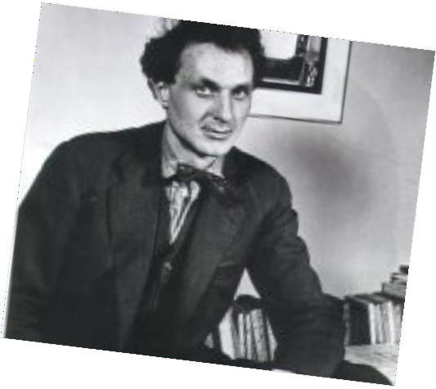
STEPHEN SPENDER
(1909-1995)
He was an English poet and essayist who took keen interest in politics declaring himself a socialist &pacifist.
BOOKS
Poems of Dedication, The Creative Element World Within World.
Social injustice, class inequalities, empathy for the downtrodden are
the major themes of his writings.

Slide 3
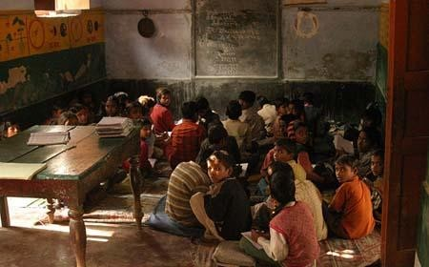
An Elementary School Classroom in a
slum

Slide 4
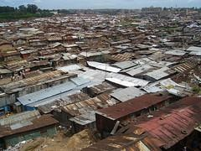

Slide 5
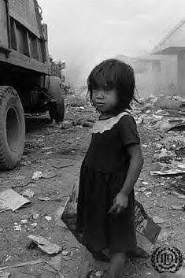
Far far from gusty waves these children's faces.
Like rootless weeds, the hair torn around their pallor.
The tall girl with her weighed-down head.

Slide 6

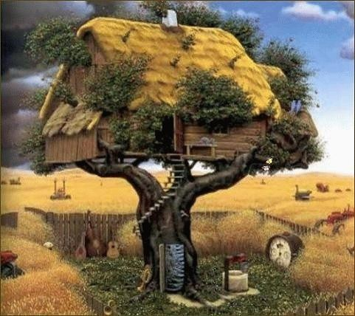
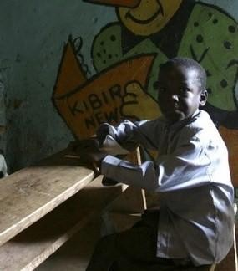
At back of the dim class One unnoted, sweet and young. His eyes live in a dream,
Of squirrel's game, in the tree room, other than this.

Slide 7


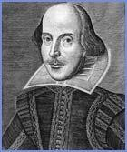
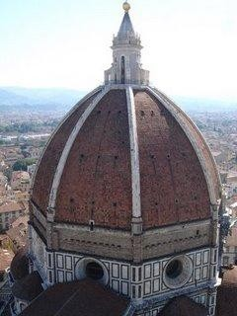

On sour cream walls, donations. Shakespeare's head,
Cloudless at dawn, civilized dome riding all cities.

Slide 8


Belled, flowery, Tyrolese valley. Open-handed map
Awarding the world its world. And yet, for these children,
these windows, not this map, their world,

Slide 9
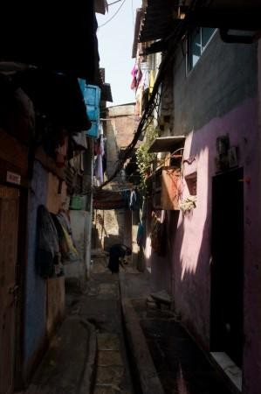
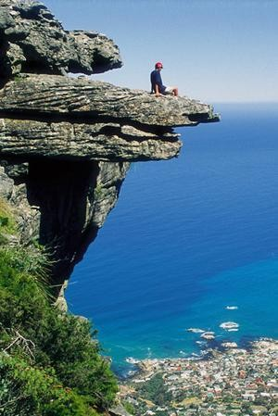
Where all their future's painted with a fog,
A narrow street sealed in with a lead sky,
Far far from rivers, capes, and stars of words.

Slide 10

Surely, Shakespeare is wicked, and the map a bad example
With ships and sun and love tempting them to steal--

Slide 11
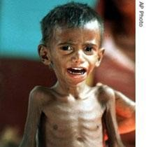
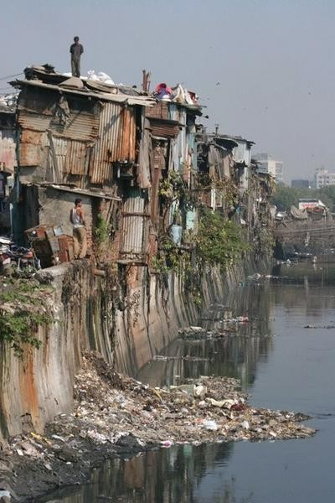
On their slag heap,these children
Wear skins peeped through by bones and
spectacles of steel
With mended glass, like bottle bits on stones.
All of their time and space
are foggy slum.
So blot their maps with slums as big as doom.

Slide 12
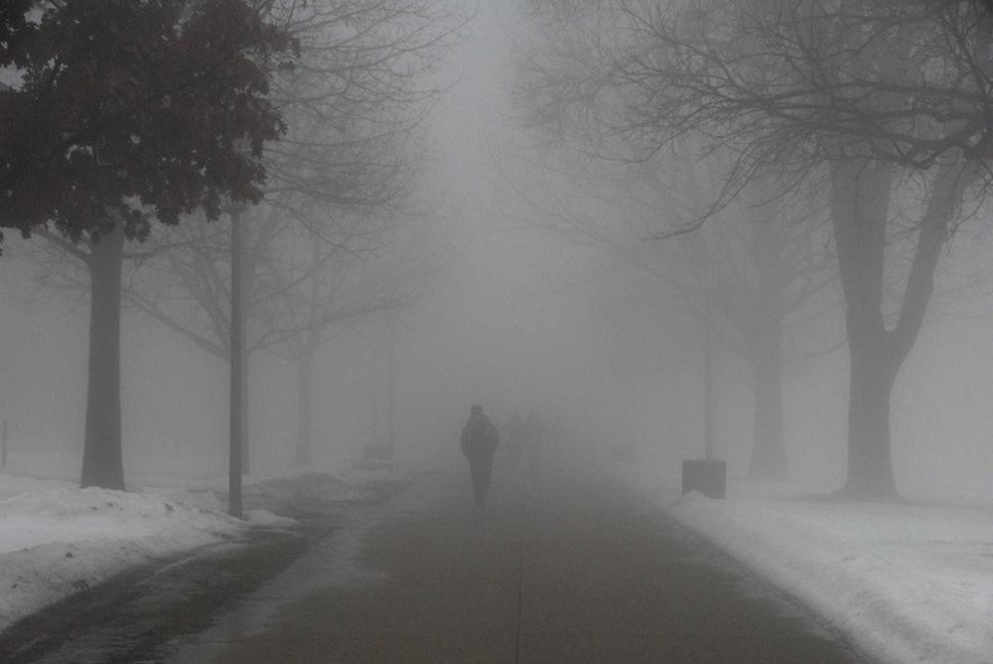
For lives that slyly turn in their cramped holes
From fog to endless night?

Slide 13
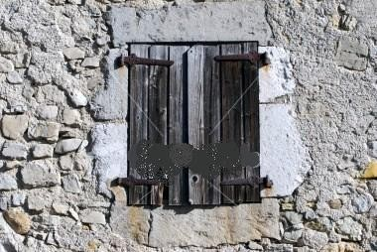
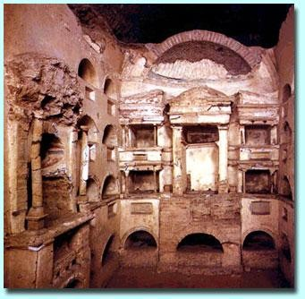
Unless, governor, teacher, inspector, visitor,
This map becomes their window and these windows
That shut upon their lives like catacombs,

Slide 14
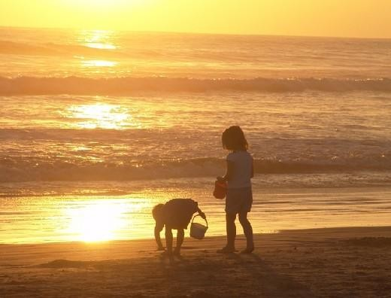
Break O break open 'till they break the town
And show the children green
fields and make their world
Run azure on gold sands, and let their tongues
Run naked into books, the white
and green leaves open
History is theirs whose language is the sun.

Slide 15

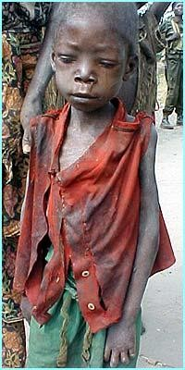
What do these images make you feel?

Slide 16
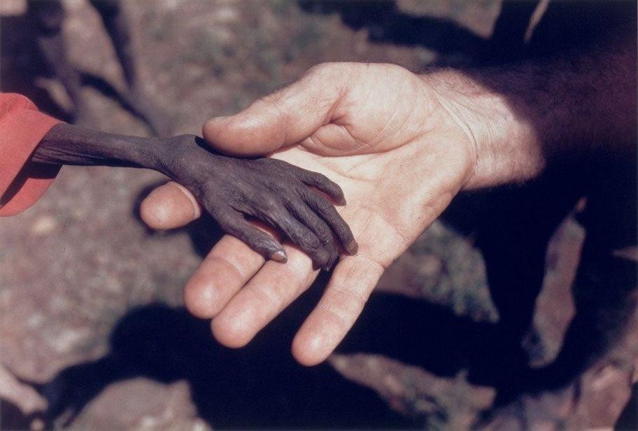
Figure of Speech: Simile
Cy an you locate the lines which use simile in the first stanza of the poem?
Cy hildren’s faces like
rootless weeds
Tyhe Paper seeming boy (Which figure of speech
has been used in this
line?)

Slide 17
Figure of speech: Metaphor
Cyan you locate the lines which use Metaphor in the poem?
Boy with rat’s eyes

Slide 18
Vacabulary
weeds: unwanted plants that grow on their own
Paper seeming boy: Very thin boy, as thin as a sheet of paper
heir: Successor
Sour: unpleasant, here refers to the colour of sour cream -off white or creamish
Donations: things given or received in charity
Dawn: early morning, sunrise
civilized dome: here, it means rising sun at the horizon which is in the shape of a dome (semi - circle)
Tyrolese valley: A beautiful ice-free valley in Austria
Sealed: shut or locked
lead: here, dark future of kids
Capes:A large piece of land that sticks out into the sea from the coast

Slide 19
Wicked: evil
Tempted: persuade
Slyly: trickily
Cramped: confined
Slag: weak
Mended: repaired
Blot: to mark with a spot
Doom: disaster
Catacombs: tomb, cemetery
Azure: deep blue

Slide 20
Explanation
The poet describes the children who study in an elementary school which is setup in a slum area. The poet says that the faces of children are dull and without any energy. They are not full of energy like other kids of their age. These children are compared to unwanted weed. Here the writer wants to say that these children seem to be unwanted like the unwanted weeds which grow on their own in the fields. Their hair is not neatly done. It falls on their pale faces as if they have been torn apart. The children are untidy, they haven’t combed their hair. Then he describes a tall girl who seems to be burdened by poverty. Her head is bent maybe because of tiredness or shame. There is another boy who is so weak and thin that he has been compared to a sheet of paper.

Slide 21
The boy’s eyes reflect greed and he wants to achieve everything. Then he describes another student who is physically disabled. The poet says that this boy is unlucky because he inherited a disease from his father due to which he has a deformed body. Instead of getting any facility from his father, he has received a disease in heritage. This disabled boy is sitting on his bench and is reciting his lesson. At the back of the class, in dim, dark area, was a small boy who was not visible to the poet as he was sitting in darkness. The poet could see his eyes which were bright and full of a dream. He was not paying attention to the class. It seemed as if he was rather interested in playing with squirrels in the tree house.

Slide 22
The poet says that the government should take notice of the problems being faced by these kids. He urges them to change the life of these kids and make the world map a reality for them. There is a need to break the restrictions which are put on them due to poverty and lack of resources. He wants the governor and public to help these kids in achieving their dreams. As this will take them away from fog to azure sky, the poet here wants to say that in this way the kids can be taken away from the darkness of their present to a bright future. He wants these kids to experience the sands and the beauty of nature as this will led to a desire of gaining knowledge. They will then go through the white and green leaves. Here white leaves depict books and green leaves depict nature. This will then result in their progress and they will be able to paint a bright future for themselves.

